Slide 1
Accidents Prediction on Pedestrian Using CNN
Name: Lakshmi Keerthi Ayyagari
Zid: Z1901169
Supervisor: Dr. Mona Rahimi
12/01/2021

Slide 2
Overview
Introduction
Aim of the study
Dataset Used
Steps involved in performing the project
Image Annotation Software
Steps explained with CNN in continuation
Evaluation
Difficulties/limitations
Future Work
Resources

Slide 3
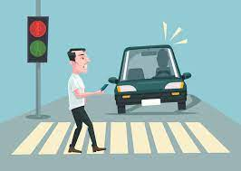
Introduction
Accidents involving pedestrians are uncommon occurrences that occur when drivers violate traffic laws; nevertheless, there may be other causes of accidents on the road.
The goal of the research is to determine whether the accident occurred or not.

Slide 4
Aim of the study
The aim of the study is to detect the number of accidents by using Image of CCTV footage.
The few questions which I am trying to answer in this study are whether the cause of accidents is due to weather conditions or if the driver is accountable for producing accidents.
Identifying accidents that occurred as a result of a driver or a pedestrian on the road are some of the questions to be analyzed.

Slide 5
Dataset used
Indian Road accidents compilation 2021 – YouTube

Slide 6
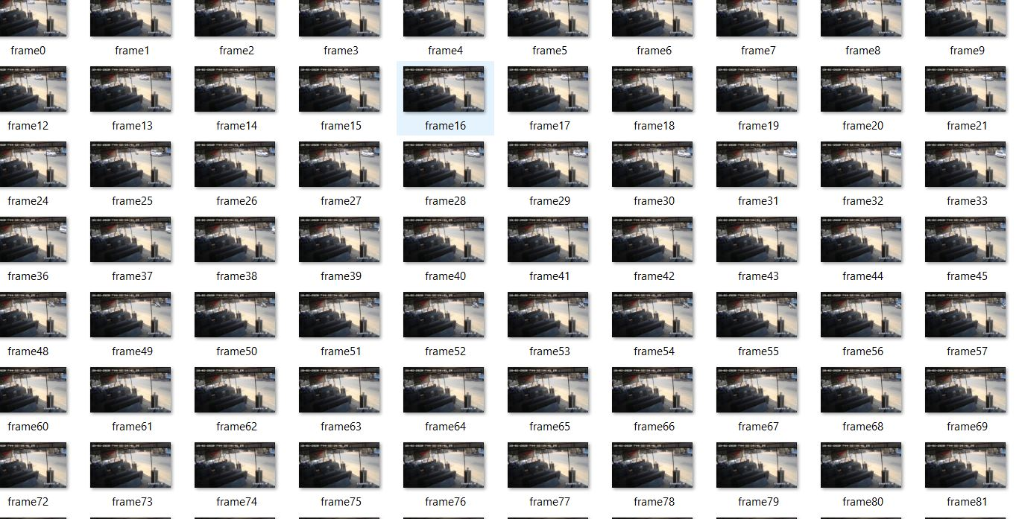
Steps involved in performing the project
Downloaded the dataset from YouTube.
Imported required necessary libraries to perform the operations.
Converting video to images/frames.

Slide 7
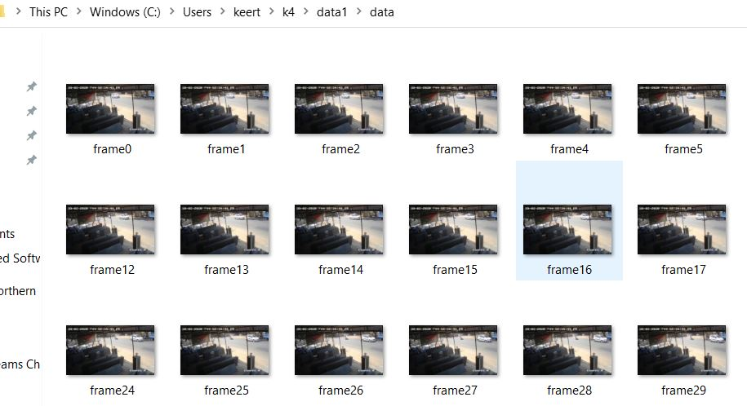
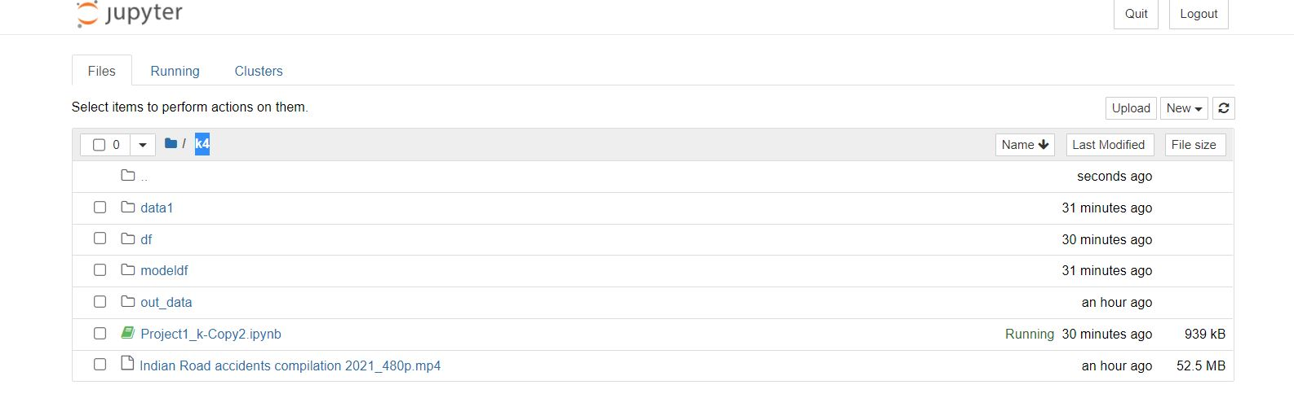
Continuation..
Using code, build a folder called data; load images/frames into the data folder; and then create a new folder called 'data1'. Transfer the data folder to the data1 folder.

Slide 8
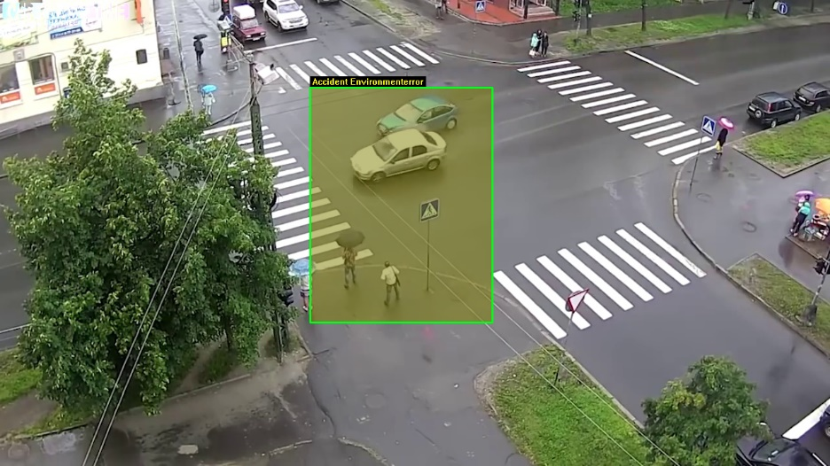
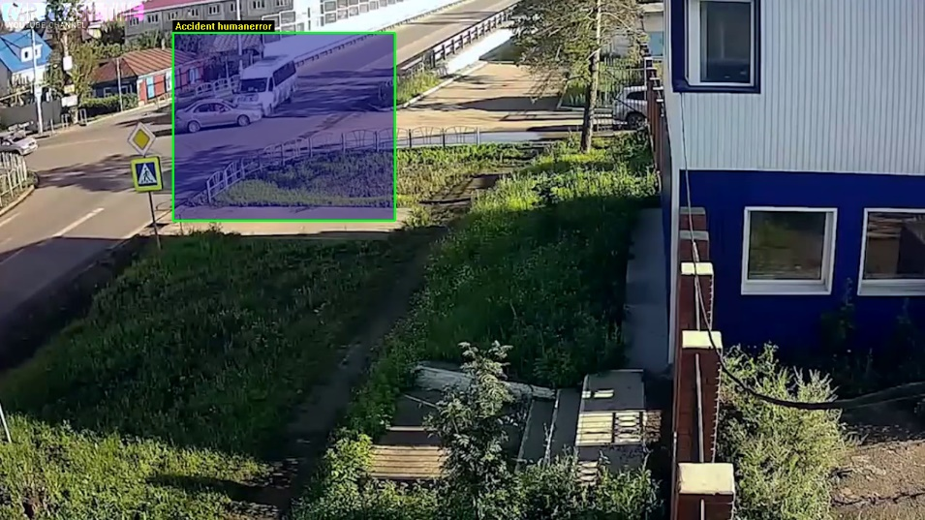
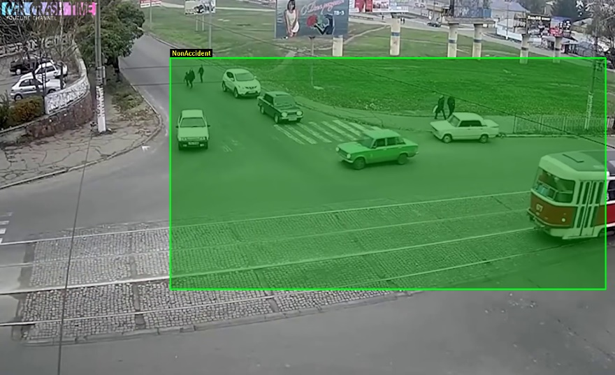
Continuation…
Split data into train, test, validate (with 80:10:10 ratio)
Labelling/Annotating images into three categories- ‘Accident Human Error’, ‘Accident Environment Error’, ‘Non-Accident’.
Label image using ‘Image Annotation Software’ (https://www.youtube.com/watch?v=scL1oTH_U_0)
and in python there is a library labelImg · PyPI.

Slide 9
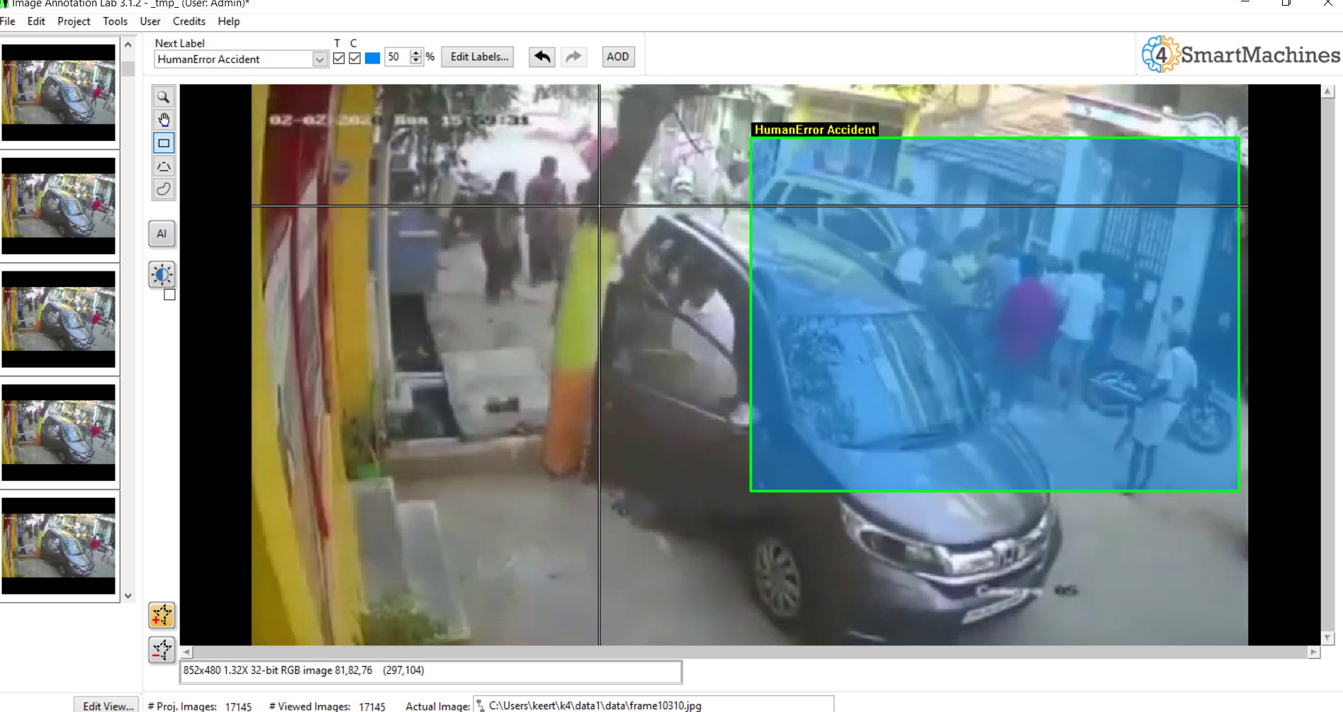
Image Annotation Software

Slide 10
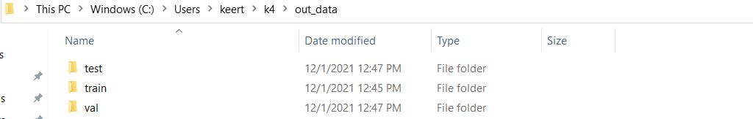
Continuation..
Imagedatagenerator to convert images into array/numbers.
Stored the arrays into train, test and validate dataframe.

Slide 11

Continuation..
Used CNN Layers for modelling/ Prediction purpose.
Fitted the training and validation data into CNN using 10 epochs.

Slide 12
Validation
Plotted training loss (loss of data) and training accuracy; did the same for validation loss and validation accuracy.
Got the results like 2.098% loss
88% accurate which is good.

Slide 13
Difficulties/limitations
Image labeling/Annotation in python
Choosing the proper batch size and epoch size was one of the tasks required to achieve a decent outcome.

Slide 14
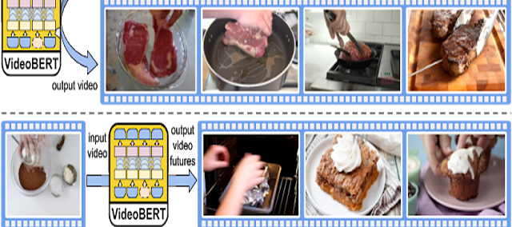
Future Work
Can try using VideoBert.

Slide 15
Resources Used
https://github.com/tzutalin/labelImg
https://youtu.be/1d7u8wTmA80
https://youtu.be/scL1oTH_U_0
https://openaccess.thecvf.com/content_ICCV_2019/papers/Sun_VideoBERT_A_Joint_Model_for_Video_and_Language_Representation_Learning_ICCV_2019_paper.pdf
https://www.youtube.com/watch?v=Jy9-aGMB_TE&t=534s
https://www.youtube.com/watch?v=umGJ30-15_A
https://pythonprogramming.net/convolutional-neural-network-kats-vs-dogs-machine-learning-tutorial/

Slide 16
Thank You

